Slide 1
Interacting with Community Datasets: Best Practices
12/8/2021
With the push for open science, the availability of public neuroimaging datasets has drastically advanced in recent years, with many more datasets being shared each year. Scientific governing bodies such as the NIH, NSF, and others have put high priority on open science data for several reasons:
Increase reproducibility of published work
Increase exploration of new analytic techniques on existing data
Expand research knowledge gained from any federally funded research

Slide 2
Learning Objectives:
Use University of Colorado Research Computing (CURC) large capacity filesystem for open access data storage (currently only available for SUMMIT)
List guidelines for CURC Summit scratch file system for data storage
Explore the use of open access data best practices

Slide 3
Summit Scratch File System...
 | Location | Quota | Use | Snapshot Backups | NAME
Home Directory | Mounted read-write on all RC resources | 2 GB | User research data storage | yes | /home/<identikey>
Project Directory | Mounted read-write on all RC resources | 250 GB | User research data storage, Not high performance | yes | /projects/<identikey>
Petalibrary | Mounted read-write on all RC resources | (allocation specific) | research data storage | yes | /pl/active/<lab>
Summit Scratch Filesystem | Mounted read-write on all SUMMIT nodes (login, compute) | 10 TB (increased on request) | Not for long-term data storage; files created more than 90 days in the past are automatically purged. | no | /scratch/summit/ <identikey>
Summit Scratch Datasets Filesystem | Mounted read-write on compute and compile SUMMIT nodes only | No Limit (soft quota 40 TB) | temporary or long term storage of reproducible data files | no | /gpfs/summit/datasets/ICS/
Blanca/ CUmulus Scratch Filesystem | Not Accessible (Go Live Summer 2022) | No Limit (soft quota 40 TB) | temporary or long term storage of reproducible data files | no | ??

Slide 4
Summit Scratch Datasets Filesystem
Use Summit Scratch Datasets Filesystem to store all open access datasets
Always check owner and group permissions for directory structure and files
Include a README.txt or similar file to describe the dataset (include data use agreements as needed and expiration dates for locally stored files)
Do not store any derivative/computational output data -- these files must be moved to your team's PetaLibrary allocation
Use clear naming conventions for all files

Slide 5
Summit Personal Scratch vs Datasets
Is your use case more suited to using Summit Scratch (USER) or Summit Scratch (Datasets)?
Summit PERSONAL Scratch Space:
/scratch/summit/<Identikey>
-- Increased flexibility on data storage
--!! Purged Every 90 days !!
Summit DATASETS Scratch Space:
/gpfs/summit/datasets/ICS/
-- shared resource... be responsible
-- No limitation on time data is retained

Slide 6
Summit Compute Resources
Summit Computing Cluster is a free, University funded computing cluster managed by CURC.
ssh -X <identikey>@login.rc.colorado.edu

Slide 7
Accessing Software Modules and Mounted Filesystems
To access modules or scratch mounted filesystems on Summit, you must first launch a compile or compute node session.
 | Bash Command
Compile Node | ssh scompile
Interactive Compute Node | sinteractive --partition=shas --time=01:00:00 --nodes=1
Priority Job Submissions on Summit
sinteractive --qos=normal --partition=shas --account=<ICS-Account-Key>
** Contact Amy Hegarty or Lena Sherbakov for the ICS Account Key **

Slide 8
Best Practices for Open Access Data
Should I download datasets from the Cloud?
Pros of duplicate dataset downloads:
Fast and reliable access to your dataset any time
Searchable metadata for all files
"Traditional" method to access datasets
Cons of duplicate dataset downloads:
Expensive and occupies space on shared resources
Duplicates data already stored offsite
Risk breaking privacy or time limit agreements in Data Use Agreements

Slide 9
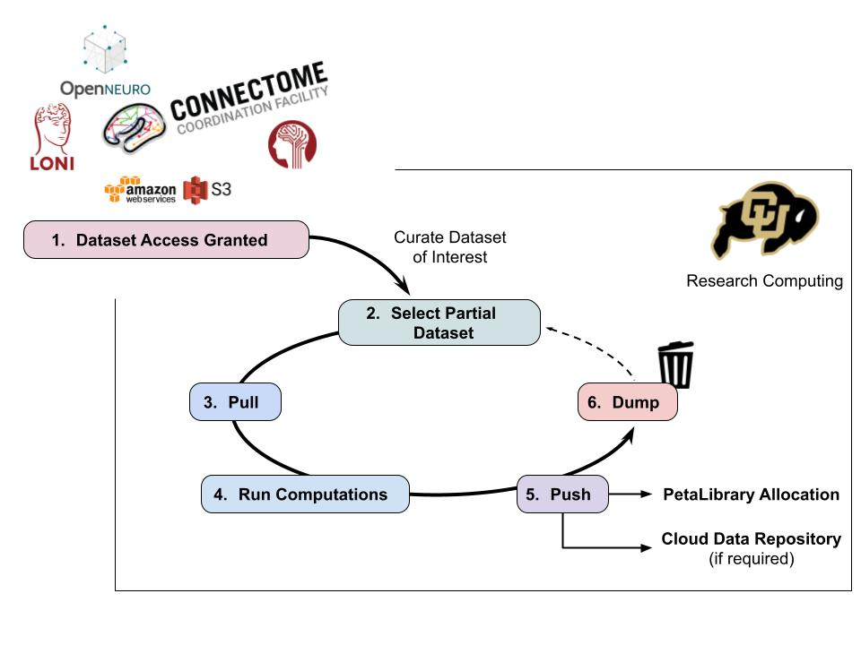

Slide 10
Next steps, lets try it on some community data!
Please Follow along: here

Slide 11
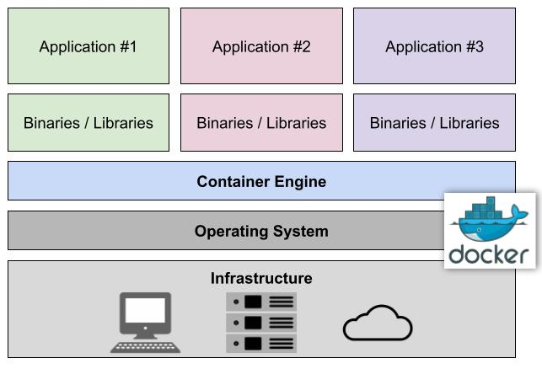
Bonus: What Are Singularity Containers?
Singularity and Docker provide a self-contained environment to run your applications
Critical research tool for reproducibility and transparency
Allows for applications to be run on restrictive compute environments (e.g. SUMMIT)

Slide 12
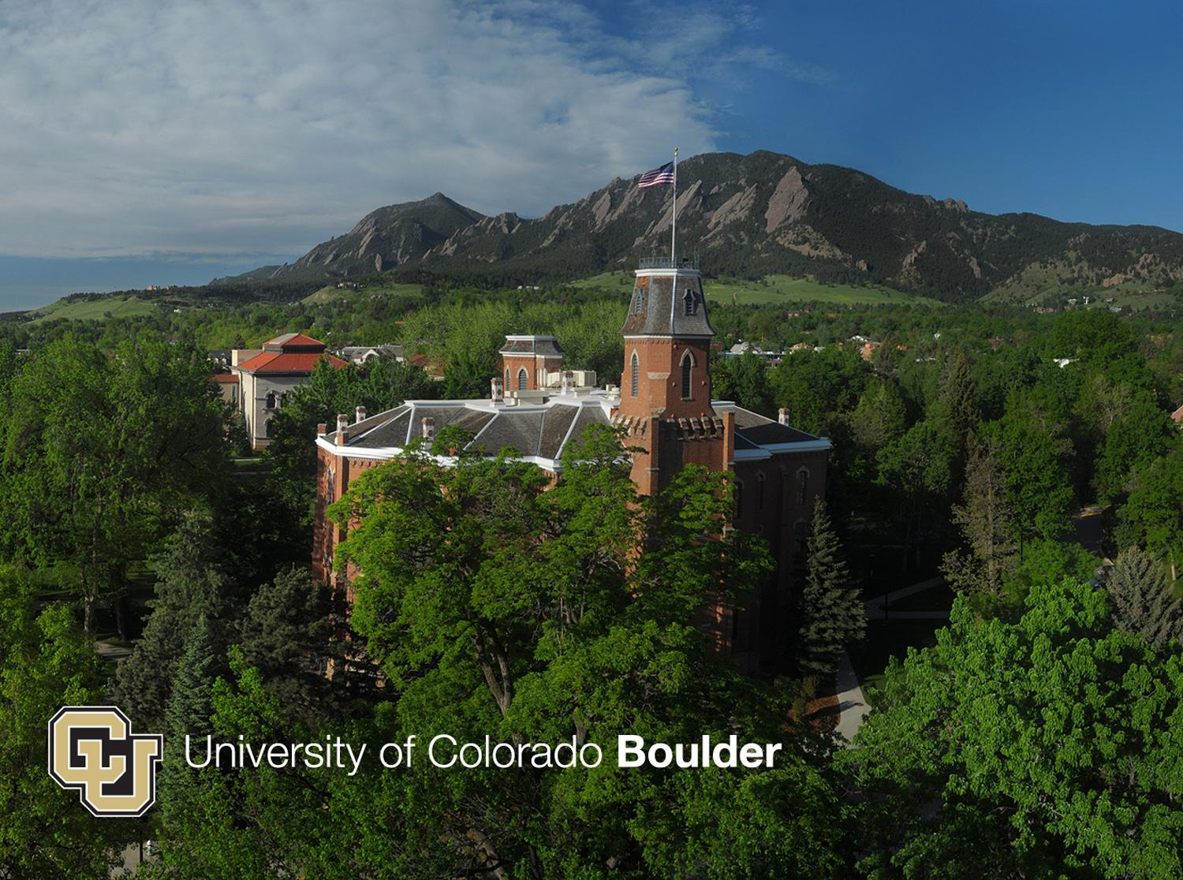
Headline

